Slide 1
Displays
Emissive display -- convert electrical energy into light
- Cathode ray tube (CRT)
- Flat panel CRT
- Plasma panels (gas-discharge display)
- Thin-film electroluminescent (EL) display
- Light-emitting diodes
Non-Emissive display -- optical effect: convert sunlight or light from other source into graphic patterns.
- Liquid-crystal device (LCD) – flat panel
- Passive-matrix LCD
- Active-matrix LCD

Slide 2
Monochrome Cathode Ray Tube (CRT)
Cathode Ray – beam of electrons
- emitted by an electron gun
- accelerated by a high positive voltage near the face of the tube
- forced into a narrow stream by a focusing system
- directed toward a point on the screen by the magnetic field generated
by the deflection coils
- hit onto the the phosphor-coated screen
- phosphor emits visible light, whose intensity depends on the number of
electrons striking on the screen
Electron gun
Cathode
Focusing
system
Horizontal
& vertical
deflection

Slide 3
Properties of the CRT
Phosphor Persistence (PP)
- the light output decays exponentially with time.
-
a phosphor’s persistence is defined as the time from the removal of
excitation to the moment of decaying the light to one-tenth of its
original intensity
- high persistence -> good for static picture with high complexity
- typical range: 10ms – 60ms
Refresh rate (RR)
- number of times per second the image is redrawn (e.g., 60 or higher)
Critical fusion frequency (CFF)
- the refresh rate above which a picture stops flickering and becomes
steady
longer PP -> lower CFF required
Notes:
Ms (millisecond – 1 one thousands of a second)

Slide 4
Fluorescence Vs Phosphorescence
When electron beam hits the screen….
After some dissipation due to heat, rest of the energy is transferred to electrons of the phosphor atoms, making them jump to higher quantum energy levels.
The excited electrons then return to their previous quantum levels by giving up extra energy in the form of light, at frequencies predicted by quantum theory.

Slide 5
Fluorescence Vs Phosphorescence
Any given phosphor has several different quantum levels to which electrons can be excited. Further, electrons on some levels are less stable and return to the unexcited state more rapidly than others.
A phosphor’s Fluorescence is the light emitted as these very unstable electrons lose their excess energy while phosphor is being struck by electrons.
Phosphorescence is the light given off by the return of relatively more stable excited electrons to their unexcited state once the electron beam excitation is removed.
Typically, most of the light emitted is phosphorescence, since the excitation and the fluorescence usually just lasts a fraction of a microsecond.

Slide 6
Properties of the CRT
Resolution
- the maximum number of points that can be displayed without overlap on
a CRT
- high-definition system, e.g. 1280 * 1024 pixels
- resolution depends on the type of phosphor, the intensity to be
displayed, focusing and deflection systems, size of video memory
Horizontal scan rate
- the number of scan lines per second that the CRT is able to display
- refresh rate * number of scan lines per frame

Slide 7
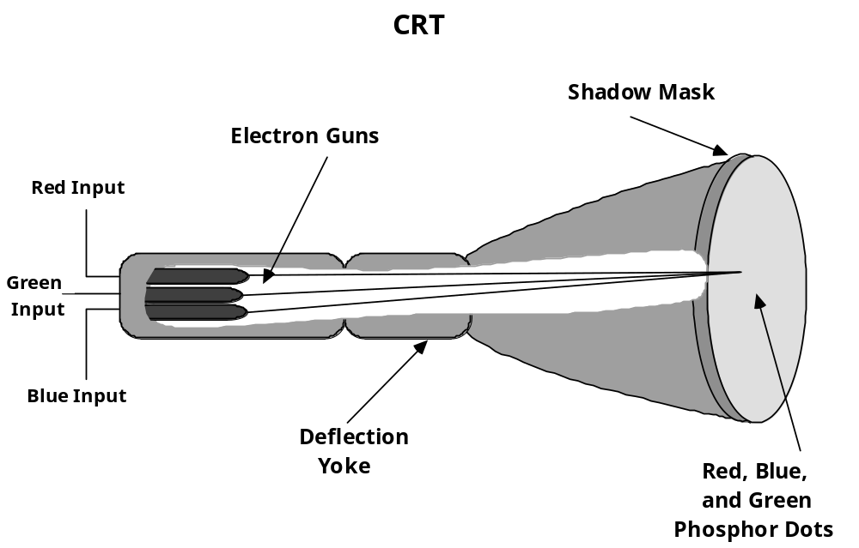
CRT Color Monitor

Slide 8
Shadow Mask
The phosphor dots are arranged in triangular triad pattern.
Shadow mask has one small hole for each phosphor triad.
Holes are precisely aligned with respect to both the triads and the electron guns.
The number of electrons in each beam controls the amount of red, blue and green light generated by the triad.
An alternate arrangement , is precision in-line delta CRT .

Slide 9
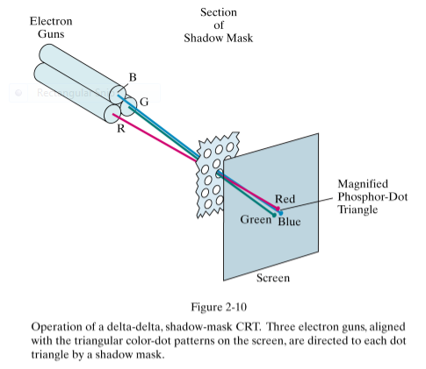

Slide 10
Shadow Mask
Shadow mask and triads impose restriction on resolution on color CRT.
High resolution tubes have triads placed on about 0.21 mm centers.
The distance is also called as pitch of the tube.
Beam diameter must be about 7/4 times pitch
Example: For mask with 0.25mm(0.01 inches) the beam is about 0.018 inches across.
Resolution can be no more than 1/0.018=55 lines/inch.
For monitor with 15.5 inches wide and 11.6 inches high resolution is
15.5*55=850 by 11.6 *55=638.

Slide 11
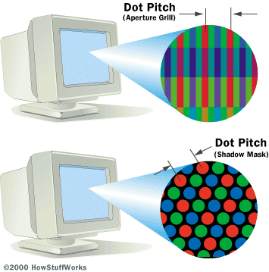
Properties of the CRT
Dot Pitch –the spacing between pixels on a CRT, measured in millimeters. Generally, the lower the number, the more detailed the image.
Notes:
Many manufacturers and retailers tend to not list the dot pitch ratings anymore. This rating refers to the size of a given pixel on the screen in millimeters. This tended to be a problem in past years as screens that attempted to do high resolutions with large dot pitch ratings tended to have a fuzzy image because of the color bleeding between pixels on the screen. Lower dot pitch ratings are preferred as it gives the display greater image clarity. Most ratings for this will be between .21 and .28 mm with most screens having an average rating of about .25 mm.

Slide 12
Flat-Panel Displays
Class of video devices that have reduced volume, weight, and power requirements compared to a CRT. They are significantly thinner.
Flat panels: i) emissive: are devices that convert electrical energy into light.
Ex:Plasma panels, thin-film electroluminescent displays, Light-Emitting Diodes (LEDs).
ii) nonemissive: use optical effects to convert sunlight or light from some other source into graphics patterns Ex: Liquid-crystal device.

Slide 13
Plasma Panel
It is an array of tiny neon bulbs. Each bulb can be turned on and off independently.
Constructed by filling the region between glass plates with a mixture of gases, usually including neon.
A series of vertical conducting ribbons is placed on one glass panel, horizontal on the other.
Voltages are fired to an intersecting pair to break down a glowing plasma of electrons and ions. Refresh rate is 60 frames per sec.

Slide 14
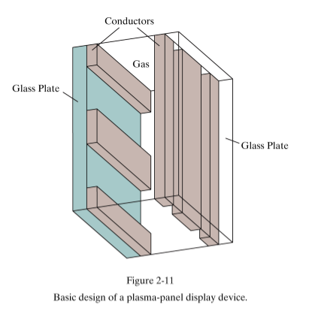
Plasma Panel

Slide 15
Output Scan Technology
Vector display
- line drawing and stroke drawing in a random order
Raster display
- horizontal scan line order

Slide 16
Vector Display
Vector display (1960s)
- vector system consists of:
display processor (controller),
display buffer memory
CRT
- The buffer stores the computer-produced display list or display program
- Display program contains point- and point-plotting commands with (x, y, z)
endpoint coordinates
- The commands for plotting are interpreted by the display processor
- The principle of vector system is random scan
The beam is deflected from endpoint to endpoint, as dictated by the order of the
display command
- display list needed to be refreshed (e.g., 30Hz)

Slide 17
Vector Display
Vector display (1960s)
:
:
Move
10
15
LINE
300
400
CHAR
Lu
cy
LINE
:
:
JMP
Host Computer
Display Controller (DC)
Lucy
Monitor
display buffer

Slide 18
Raster Display
Raster display (since 1970s)
- Raster system consists of:
display processor (input, refreshing, scan converting)
video controller
buffer memory (frame buffer)
CRT
- The buffer stores the primitive pixels, rather than display list or display program
- Video controller reads the pixel contents to produce the actual image on the
screen
- The image is represented as a set of raster scan lines, and forms a matrix of pixels.
- need refresh the raster display (e.g., 60Hz)

Slide 19
Raster Display
Raster display
Host Computer
Display Processor
Lucy
Video Controller
Lucy
Frame buffer
Monitor

Slide 20
Common Raster Display System
Peripheral
Devices
CPU
System bus
Display Processor
System
Memory
Display
Video
Controller
Display
Processor
Memory
Frame
Buffer

Slide 21

BASIC DEFINITIONS
RASTER: A rectangular array of points or dots.
PIXEL (Pel): One dot or picture element of the raster
SCAN LINE: A row of pixels
Video raster devices display an image by sequentially drawing out the pixels of the scan lines that form the raster.

Slide 22
Raster Display
Raster scan with blanked retrace
Horizontal retrace
Vertical retrace
Scan line

Slide 23
Scanning An Image
Frame: The image to be scanned out on the CRT.
•Some minimum number of frames must be redisplayed (or refreshed) each second to eliminate flicker in the image.
•Critical Fusion Frequency --The refresh rate above which a picture stops flickering and fuses into a steady image is called the critical fusion frequency.
Typically 60 times per second for raster displays.
•Varies with intensity, individuals, phosphor persistence, room lighting.

Slide 24
Video Controller
Access the frame buffer to refresh the screen
Control the operation for display
Color look-up table
Linear
address
X
address
Frame
buffer
Raster-scan
generator
Horizontal
& vertical
Deflection signal
Y
address
Data
Pixel
values
Intensity
or color

Slide 25
Video Controller
Types of refresh
Interlaced (mostly for TV for reducing flickering effect -- NTSC)
- two fields for one frame
- odd-field: odd-numbered scan lines
- even-field: even-numbered scan lines
- refresh rate: e.g., NTSC: 60Hz (60 fields per second); 30 frame/s.
PAL: 50Hz
Non-interlaced (mostly for monitor)
- refresh rate: e.g., 60Hz or more
Odd-field
Even-field
Notes:
PAL –Short for Phase Alternating Line, the dominant television standard in Europe. The United States uses a different standard, NTSC. Whereas NTSC delivers 525 lines of resolution at 60 half-frames per second, PAL delivers 625 lines at 50 half-frames per second. Many video adapters that enable computer monitors to be used as television screens support both NTSC and PAL signals.
(Phase Alternating Line) A color TV standard that was developed in Germany. It broadcasts 25 interlaced frames per second (50 half frames per second) at 625 lines of resolution. Brazil uses PAL M, which broadcasts 30 fps. PAL is used throughout Europe and China as well as in various African, South American and Middle Eastern countries. PAL's color signals are maintained automatically, and the TV set does not have a user-adjustable hue control. See NTSC and SECAM.
NTSC –Short for National Television System Committee. The NTSC is responsible for setting television and video standards in the United States (in Europe and the rest of the world, the dominant television standards are PAL and SECAM). The NTSC standard for television defines a composite video signal with a refresh rate of 60 half-frames (interlaced) per second. Each frame contains 525 lines and can contain 16 million different colors. The NTSC standard is incompatible with most computer video standards, which generally use RGB video signals. However, you can insert special video adapters into your computer that convert NTSC signals into computer video signals and vice versa.
(National TV Standards Committee) A color TV standard that was developed in the U.S. Administered by the FCC, NTSC broadcasts 30 interlaced frames per second (60 half frames per second, or 60 "fields" per second in TV jargon) at 525 lines of resolution. The signal is a composite of red, green and blue and includes an audio FM frequency and an MTS signal for stereo. NTSC is used throughout the world, including the U.S., Canada, Japan, South Korea and several Central and South American countries. See PAL, SECAM and ATSC.
SECAM –(Systeme En Couleur Avec Memoire) A color TV standard that was developed in France. It broadcasts 25 interlaced frames per second (50 half frames per second) at 625 lines of resolution. SECAM is used in France and Russia and many countries in Africa, Eastern Europe and the Middle East. See NTSC and PAL.

Slide 26
Display Processor
Also called either a Graphics Controller or Display CoProcessor
Specialized hardware to assist in scan converting output primitives into the frame buffer.
Fundamental difference among display systems is how much the display processor does versus how much must be done by the graphics subroutine package executing on the general-purpose CPU.

Slide 27
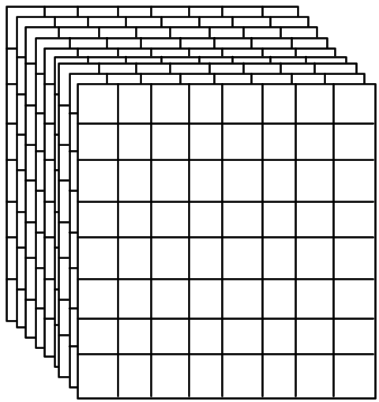
Frame Buffer
A frame buffer may be thought of as computer memory organized as a two-dimensional array with each (x,y) addressable location corresponding to one pixel.
Bit Planes or Bit Depth is the number of bits corresponding to each pixel.
A typical frame buffer resolution might be
640 x 480 x 8
1280 x 1024 x 8
1280 x 1024 x 24

Slide 28
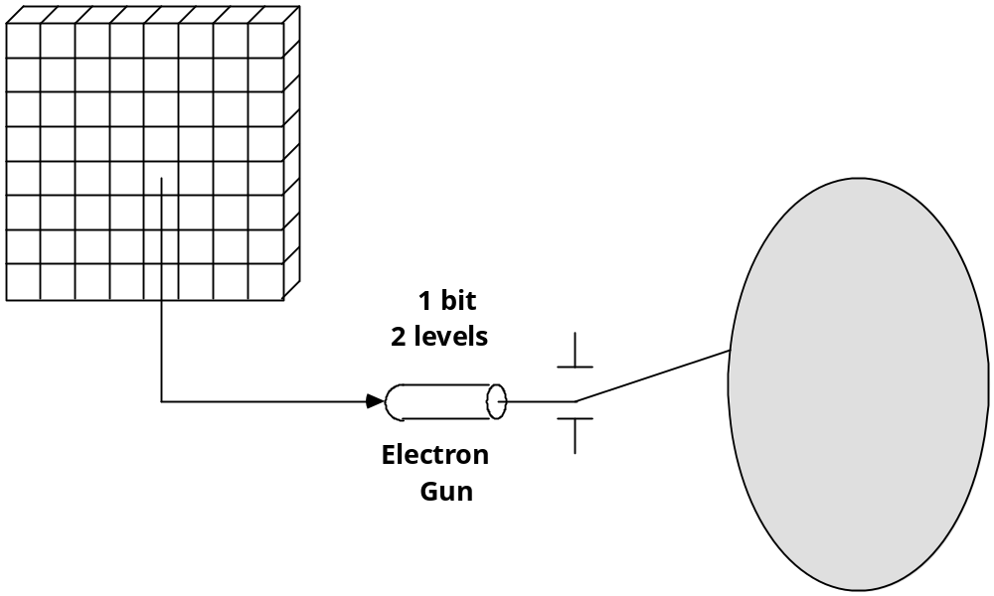
1-Bit Memory. Monochrome Display
(Bit-map Display)
Notes:
(1280 X 1024 X1) = 163840 bytes or 160 KB

Slide 29
3-Bit Color Display
3
red
green
blue
COLOR: black red green blue yellow cyan magenta white
R
0
1
0
0
1
0
1
1
G
0
0
1
0
1
1
0
1
B
0
0
0
1
0
1
1
1
Notes:
(1280 X 1024 X 3)/8 = 480 KB

Slide 30
True Color Display
24 bitplanes, 8 bits per color gun. 2²⁴ = 16,777,216 colors
8
8
8
Red
Green
Blue
Notes:
(1280 X 1024 X 24 ) = 3,840 KB or 3,932,160 bytes

Slide 31
Color Look-up Table
LUT (Look-Up Table)
LUT has as many entries as there are pixel values, the values in the bit planes are used as indices into one or more LUT.
A pixel value is used not to control the beam directly, but rather as an index into the look-up table.
The table entry’s value is used to control the intensity or color of the CRT.
for example:
If each pixel consists of 8 bits in the frame buffer the LUT requires a table with 256 entries.
Pixel value 67 → access the content in the entry 67 of the table → use the color
content to control the CRT beam
The total number of bits in each table entry is called the width of the LUT,
which is the capability for providing all possible colors
The look-up operation is done for each pixel on each display cycle, fast access of the table is required.
LUT can be loaded on program command.

Slide 32
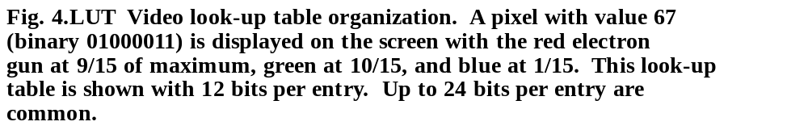
Color Map Look-Up Tables
Extends the number of colors that can be displayed by a given number of bit-planes.
y
RED
max
GREEN
255
BLUE
1
1
0
y
0
0
67
Pixel displayed
0
1
1001
1010
0001
at x', y'
0
67
100110100001
R
G
B
Pixel in
bit map
0
0
at x', y'
0
x
x
max
Frame Buffer
Look-up table
Display
Notes:
Frame Buffer takes up 8 X 1280 X 1024 = 1,310,720 bytes
Look Up table takes up 256 X 12/8 = 384 bytes.

Slide 33
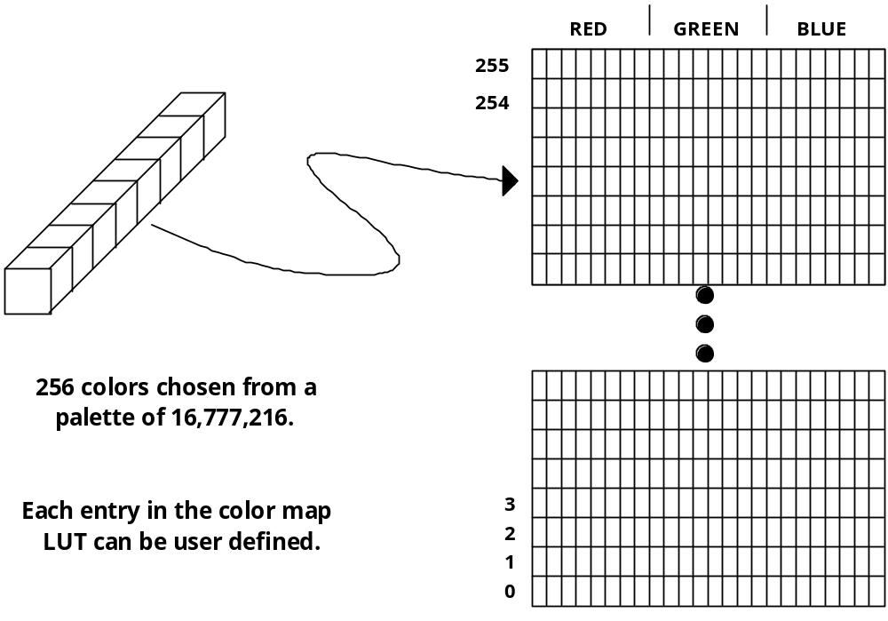
Pseudo Color: 2⁸ x 24 Color Map LUT
Could be used to define 256 shades of green or 64 shades each of red, blue, green and white, etc.

Slide 34
Color Look-up Table
The number of the bit planes in the frame buffer→ determines the number of colors displayable on the screen simultaneously
The width of the LUT determines the number of possible colors that we can choose from (also called the color palette)
Example:
8 bit planes → 2⁸ or 256 colors can be displayed simultaneously
A LUT width of 12 bits → color palette consists of 2¹² colors in all

Slide 35
Vector Display vs. Raster Display
Vector display
Accurate (high resolution) for line drawings
Requires display processor (controller) to interpret display commands
High-cost
Flickering when the number of primitives in the buffer becomes too large
Raster display
Low-cost
Requires frame buffer
Fresh rate is independent of complexity of the display contents
Easy to fill a region
Line or polygon must be scan-converted into the component pixels in the frame buffer, which is computationally expensive.
Less accurate: lines are approximated with pixels on the raster grid.
This visual effect (I.e., jaggies or stair-casing) due to a sampling error is called “aliasing”

